Slide 1
Brian Vineyard
Data Analyst Portfolio

Slide 2
Skills and Experience
Data Cleaning and Transformation
Load data from: Live SQL DB connections, Text Files, PDF, Web
Clean data: Remove duplicates, look for missing/invalid values
Transform data using Power Query to set data types, modify columns/values
Model Data
Set up relational DB tables with primary / foreign keys
Design pivot tables and DAX formulas to model data based on Key Performance Indicators (KPI)
Optimize queries for performance and processing large datasets
Reports and Dashboards
Build clean dashboards and reports that use best practices to convey key points
Collaborate with Stakeholders and Continuously Improve Reports
Regular cadence of updates to meet current needs and ensure best end-user experience
Presentation and Technical Writing
Skilled at presenting results in formal presentations to entire company including CEO and board
Technical documentation, help files, and knowledgebase content

Slide 3
Work Samples
Power BI
Jira IT Service Desk
Video Game Sales
International Skating Union (ISU) Ice Skating Competitions
Adventure Works
Maven Market
Fitness Tracker
Tableau
Netflix Movies and TV Shows
Excel
Superstore Financials

Slide 4
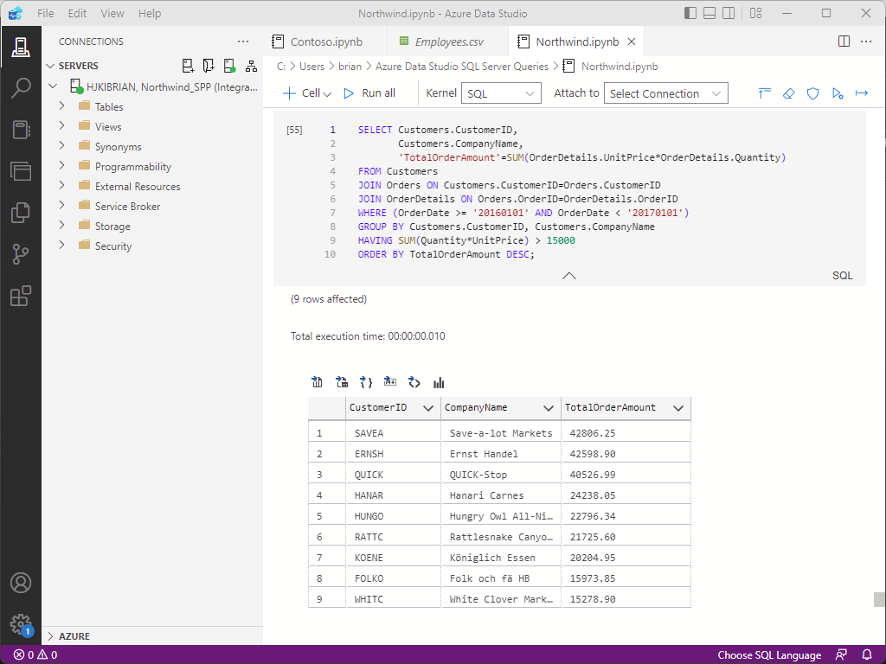
SQL: SQL Server, SSMS, Azure Data Studio
This query is in an Azure Data Studio notebook connected to the Northwind database in SQL Server.
This returns the CustomerID,
CompanyName and TotalOrderAmount
for orders with totals greater than $15,000
in 2016.
Results can be saved as a .CSV file, or
produced as visual charts.
Azure Data Studio is a free tool and with
Python and Jupyter Notebooks are a great way to do analysis at no cost.
These tools also handle large datasets.

Slide 5
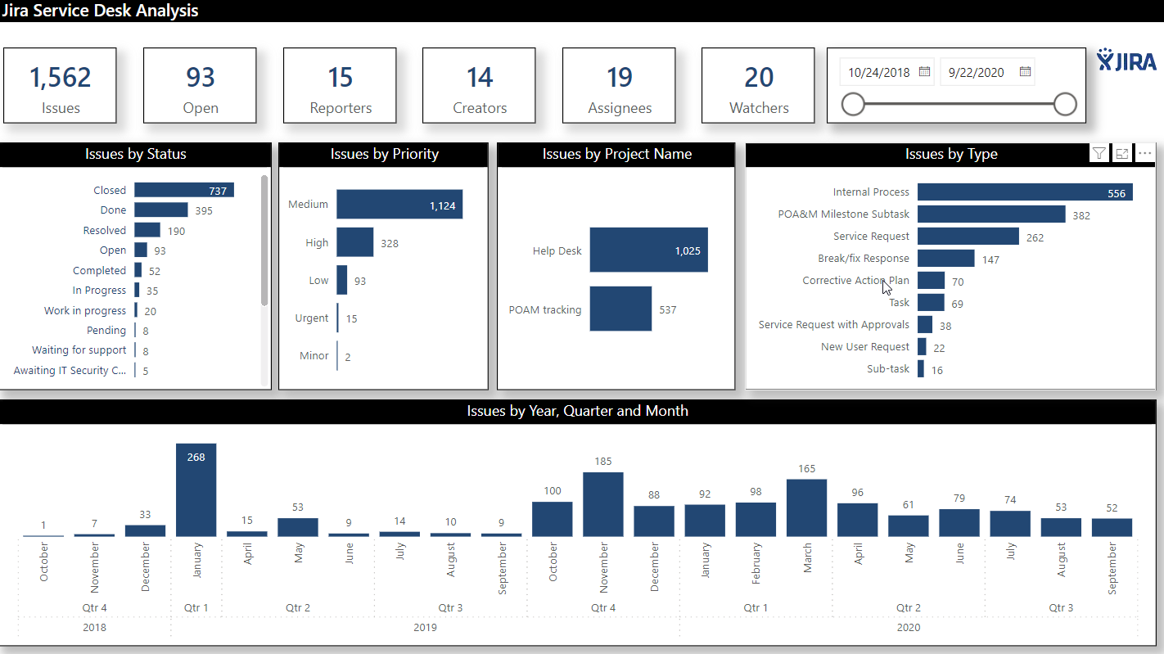
Dataset: Jira IT Service Desk Analysis with sample data for over 1,500 issues from Dec 2018 – Sep 2020

Slide 6
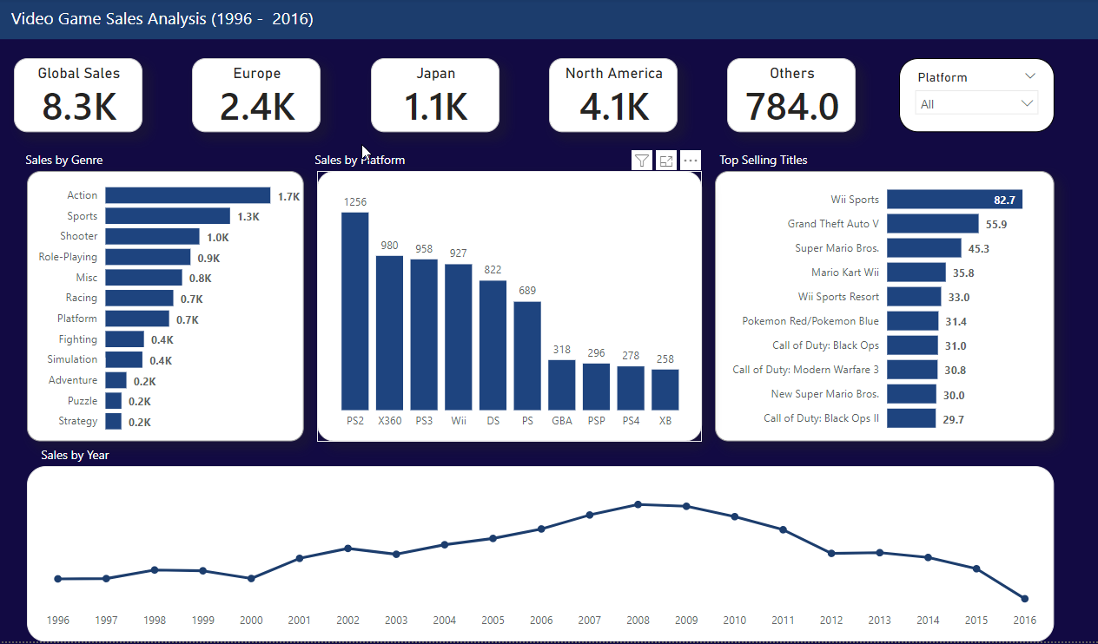
Dataset: Video Game Sales Analysis with data of top selling titles by region for 20 year span: 1996 – 2016

Slide 7
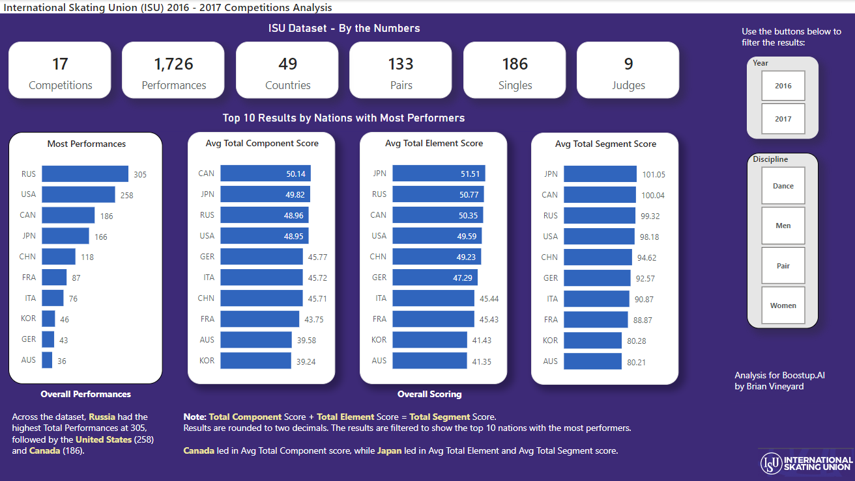
International Skating Union (ISU) Ice Skating Competition Analysis
Dataset: ISU Skating Competition Analysis from BuzzFeed News with data from Oct 2016 – Dec 2017

Slide 8
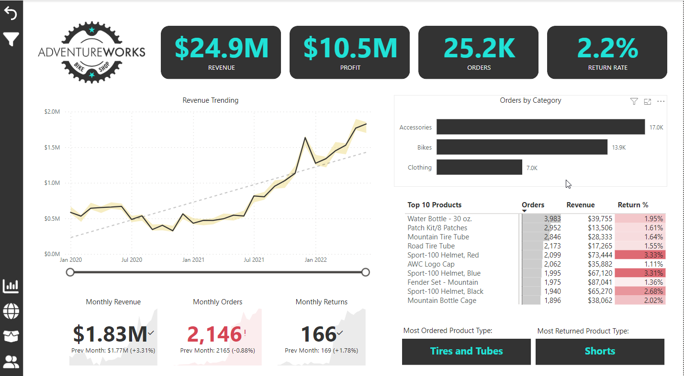
Dataset: Adventure Works for SQL Server 2022 with sample data for almost 58,000 sales records

Slide 9
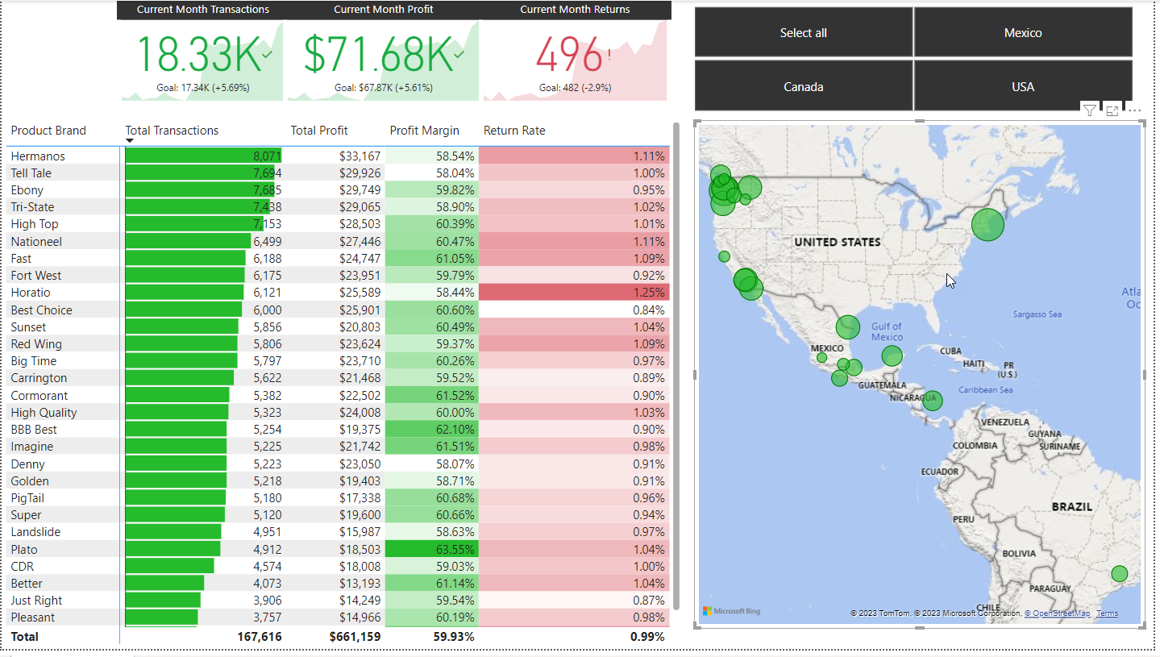
Power BI: Maven Market Financial Report

Slide 10
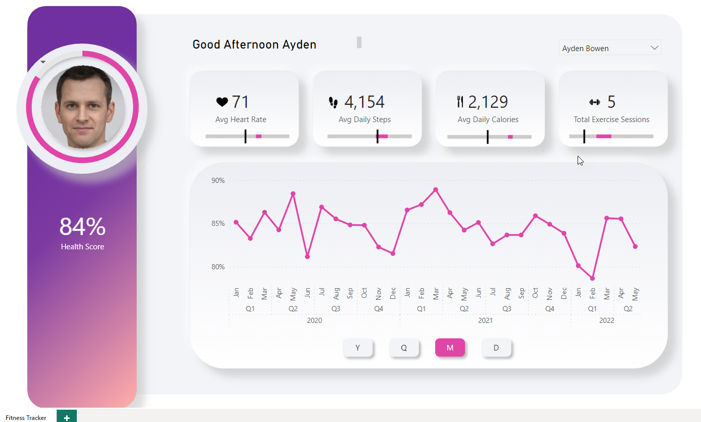
Power BI: Fitness Tracker App – for mobile use
Designed to look
like iOS mobile apps
DAX custom greeting based on time of day
Slicers to view results by day, month, year and quarter.
Minimal colors
Uncluttered design
Health Score over time showing results by year, quarter, month and day

Slide 11
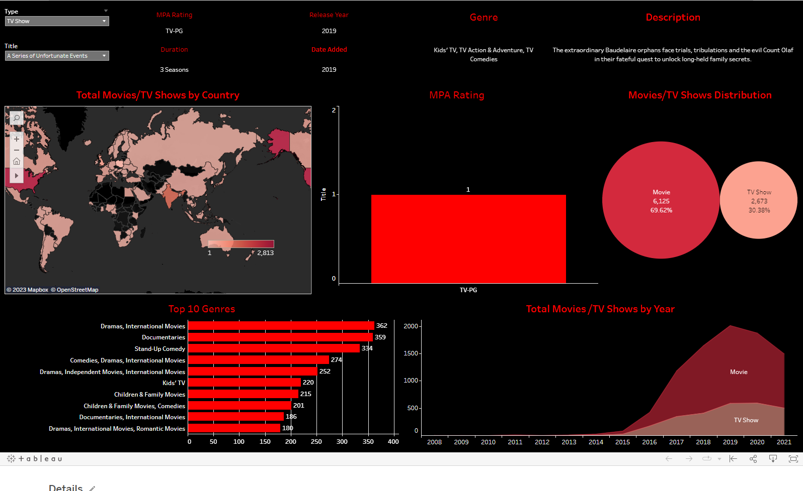
Tableau: Netflix Data
This dashboard is
available on Tableau
Public at https://public.tableau.com/app/profile/brian.vineyard/viz/netflix_16879639661060/Netflix
View Netflix
Movies and TV Shows
and select countries
using the world map to
see the most popular results in that region.

Slide 12
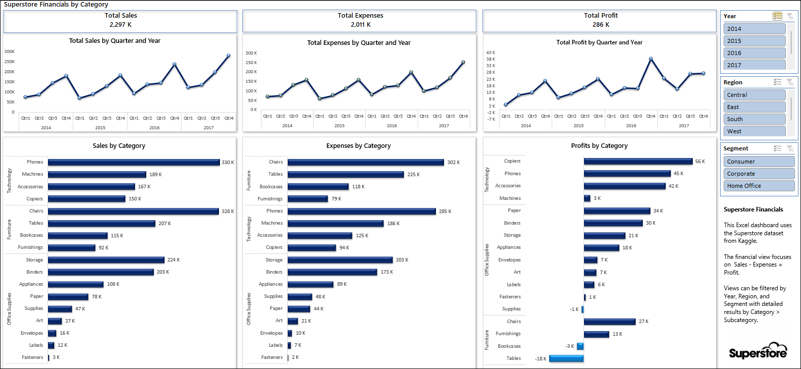
Excel: Superstore Financials
Note: Modeling based on Category / Subcategory shows the most and least profitable products.

Slide 13
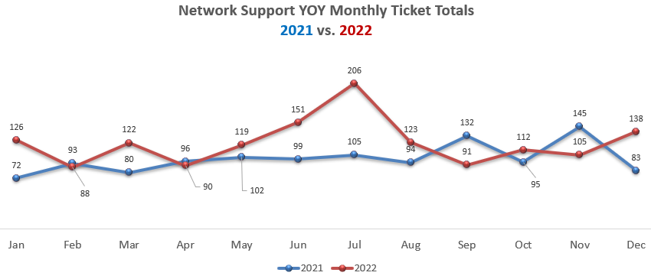
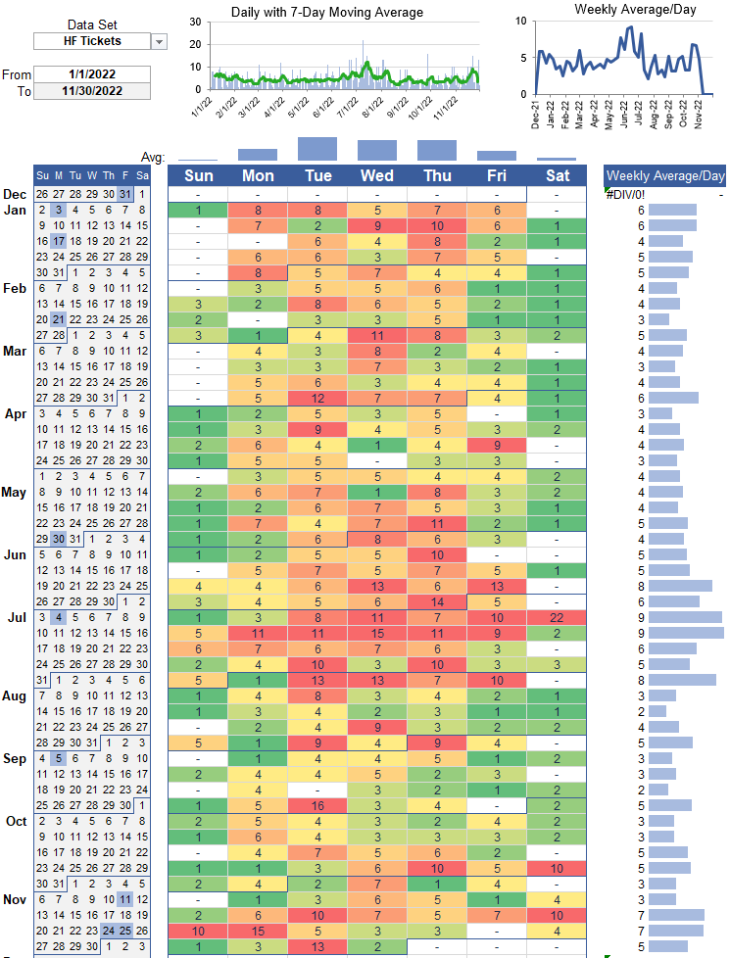
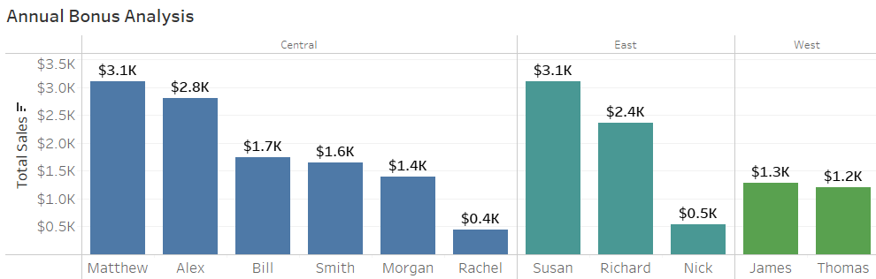
Report Visualizations
Line chart showing results over time
Calendar heat map showing daily case volume, company holidays, daily & weekly averages.
Bar chart showing categorical data comparison

